Slide 1
Sorting

Slide 2
Sorting
Sorting refers to arranging data in a particular format.
Sorting algorithm specifies the way to arrange data in a particular order.
Most common orders are in numerical or lexicographical order.

Slide 3
Sorting
The importance of sorting lies in the fact that data searching can be optimized to a very high level, if data is stored in a sorted manner.
Sorting is also used to represent data in more readable formats

Slide 4
Sorting
Some real-life scenarios −
Telephone Directory − The telephone directory stores the telephone numbers of people sorted by their names, so that the names can be searched easily.
Dictionary − The dictionary stores words in an alphabetical order so that searching of any word becomes easy.

Slide 5
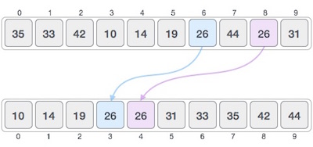
Stable and Not Stable Sorting
If a sorting algorithm, after sorting the contents, does not change the sequence of similar content in which they appear, it is called stable sorting.

Slide 6
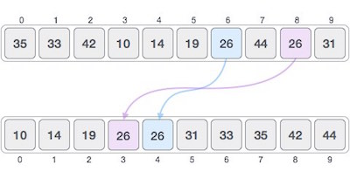
Stable and Not Stable Sorting
If a sorting algorithm, after sorting the contents, changes the sequence of similar content in which they appear, it is called unstable sorting.

Slide 7
Stable and Not Stable Sorting
Stability of an algorithm matters when we wish to maintain the sequence of original elements, like in a tuple for example.

Slide 8
Stable and Not Stable Sorting
Stability is mainly important when we have key value pairs with duplicate keys possible (like people names as keys and their details as values). And we wish to sort these objects by keys.
What is it? A sorting algorithm is said to be stable if two objects with equal keys appear in the same order in sorted output as they appear in the input array to be sorted.

Slide 9
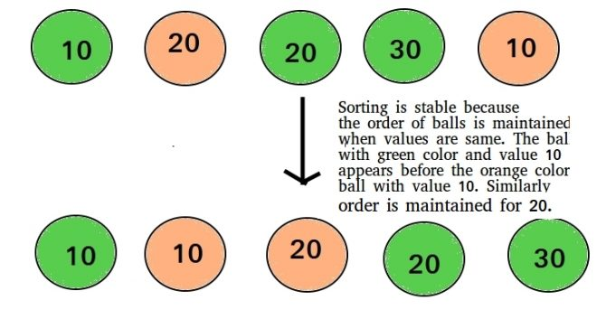
Stable and Not Stable Sorting

Slide 10
Bubble Sort
Bubble sort is an algorithm that compares the adjacent elements and swaps their positions if they are not in the intended order.

Slide 11
Bubble Sort
For sorting N elements, The steps are-
Pass 1
First Compare 1st element with 2nd element of array, If 1st<2nd then compare 2nd with 3rd
If 2nd>3rd then interchange value of 2nd and 3rd
Now compare 3rd value with 4th
Similarly compare until N-1th element is compared with Nth element
Now the highest value is reached at Nth place
Pass 2
Now elements will be compared until N-1 elements

Slide 12
Bubble Sort
In each iteration, the comparison takes place up to the last unsorted element.
The array is sorted when all the unsorted elements are placed at their correct positions.

Slide 13
Bubble Sort
Let the elements be-
13,32,20,62,68,52,38,46
Pass1
Compare 1st ,2nd element, 13<32 No change
Compare 2nd,3rd element, 32>20,Interchange
13,20,32,62,68,52,38,46

Slide 14
Bubble Sort
13,20,32,62,68,52,38,46
Compare 3rd,4th element, 32<62 No change
Compare 4th,5th element, 62<68 No change
Compare 5th,6th element, 68>52 Interchange
13,20,32,62,52,68,38,46
Compare 6th,7th element, 68>38 Interchange
13,20,32,62,52,38,68,46
Compare 7th ,8th element, 68>46 Interchange
13,20,32,62,52,38,46,68
Pass 1 completed,
The Biggest element has reached the last position

Slide 15
Bubble Sort
13,20,32,62,52,38,46,68
Pass 2
Now showing only interchange
62>52, so 13,20,32,52,62,38,46,68
62>38, so 13,20,32,52,38,62,46,68
62>46 so 13,20,32,52,38,46,62,68
After Pass 2, second largest element reaches 2nd last position

Slide 16
Bubble Sort
13,20,32,52,38,46,62,68
Pass 3
Now showing only interchange
52>38 so 13,20,32,38,52,46,62,68
52>46 so 13,20,32,38,46,52,62,68
After Pass 3, 3rd largest element reaches 3r^{d} last position
13,20,32,38,46,52,62,68
Pass 4
No of Exchanges=0, so list is sorted

Slide 17
Bubble Sort
Analysis-
1st Pass………..=n-1 Comparisons
2nd Pass……….=n-2 Comparisons
3rd Pass……….=n-3 Comparisons
Total no of comparisons=(n-1)+(n-2)+(n-3)+………..+3+2+1
=Arithmetic Progression AP
Sum=n/2[2a+(n-1)d]
=n(n-1)/2
=O(n²)

Slide 18
Bubble Sort
Analysis-
This algorithm is not suitable for large data sets as its average and worst case complexity are of Ο(n²) where n is the number of items.
It behaves as O(n) for Sorted array

Slide 19
Bubble Sort
How many Passes are needed to sort the following list of numbers? 5 1 4 2 8

Slide 20
Bubble Sort
First Pass: ( 5 1 4 2 8 ) –> ( 1 5 4 2 8 ), Here, algorithm compares the first two elements, and swaps since 5 > 1. ( 1 5 4 2 8 ) –> ( 1 4 5 2 8 ), Swap since 5 > 4 ( 1 4 5 2 8 ) –> ( 1 4 2 5 8 ), Swap since 5 > 2 ( 1 4 2 5 8 ) –> ( 1 4 2 5 8 ), Now, since these elements are already in order (8 > 5), algorithm does not swap them.
Second Pass: ( 1 4 2 5 8 ) –> ( 1 4 2 5 8 ) ( 1 4 2 5 8 ) –> ( 1 2 4 5 8 ), Swap since 4 > 2 ( 1 2 4 5 8 ) –> ( 1 2 4 5 8 ) ( 1 2 4 5 8 ) –> ( 1 2 4 5 8 ) Now, the array is already sorted, but our algorithm does not know if it is completed. The algorithm needs one whole pass without any swap to know it is sorted.
Third Pass: ( 1 2 4 5 8 ) –> ( 1 2 4 5 8 ) ( 1 2 4 5 8 ) –> ( 1 2 4 5 8 ) ( 1 2 4 5 8 ) –> ( 1 2 4 5 8 ) ( 1 2 4 5 8 ) –> ( 1 2 4 5 8 )

Slide 21
Bubble Sort
// A function to implement bubble sort
void bubbleSort(int arr[], int n)
{
int i, j;
for (i = 0; i < n-1; i++)
// Last i elements are already in place
for (j = 0; j < n-i-1; j++)
if (arr[j] > arr[j+1])
swap(&arr[j], &arr[j+1]);
}

Slide 22
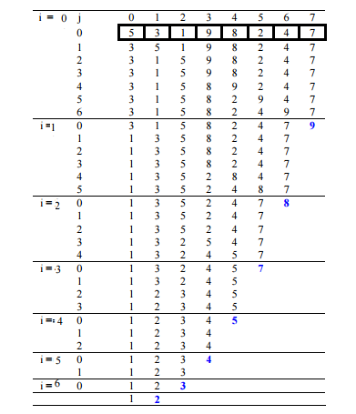
Bubble Sort

Slide 23
Shell Sort
The idea of shellSort is to allow exchange of far items.
Compare elements that are distant apart rather than adjacent elements

Slide 24
Shell Sort
We calculate interval for each pass and select the element after the interval
Afterward we decrease the increment and do this process again
At last we take increment =1 and sort them

Slide 25
Shell Sort
Let us take an array from arr[0]……….arr[N-1]
Lets take the distance/increment=4 for grouping distant elements together.
The groups will be-
First:arr[0],arr[4],arr[8]………
Second:arr[1],arr[5],arr[9]……….
Third:arr[2],arr[6],arr[10]………
Fourth:arr[3], arr[7], arr[11]…..
First we sort these lists then decrease the increment and do this process again
At the end list is maintained with increment 1

Slide 26
Shell Sort
We take decreasing increments for sorting the list
Also called Diminishing Increment Sort

Slide 27
Shell Sort
Let us take elements=75,35,42,13,87,24,64,57
Pass 1: (increment =5)
75 | 35 | 42 | 13 | 87 | 24 | 64 | 57
24 | 35 | 42 | 13 | 87 | 75 | 64 | 57

Slide 28
Shell Sort
Pass 2: (increment =3)
24 | 35 | 42 | 13 | 87 | 75 | 64 | 57
13 | 35 | 42 | 24 | 57 | 75 | 64 | 87

Slide 29
Shell Sort
Pass 3: (increment =1)
Shell sort uses insertion sort to sort the array.
13 | 35 | 42 | 24 | 57 | 75 | 64 | 87

Slide 30
Shell Sort
Pass 3: (increment =1)
13 | 35 | 42 | 24 | 57 | 75 | 64 | 87
13 | 35 | 42 | 24 | 57 | 75 | 64 | 87
13 | 24 | 35 | 42 | 57 | 75 | 64 | 87
13 | 24 | 35 | 42 | 57 | 75 | 64 | 87
13 | 24 | 35 | 42 | 57 | 75 | 64 | 87
13 | 24 | 35 | 42 | 57 | 75 | 64 | 87
13 | 24 | 35 | 42 | 57 | 64 | 75 | 87
13 | 24 | 35 | 42 | 57 | 64 | 75 | 87

Slide 31
Shell Sort
There is no restriction on sequence of increments but it should be 1 at the last
Avoid taking increments of power of 2 as 4,2,1 because the items compared at one pass will be compared again at the next pass

Slide 32
Shell Sort
Illustrate the steps of Shell Sort on the list-
54,26,93,17,77,31,44,55,20
Take increment=3 and 1

Slide 33
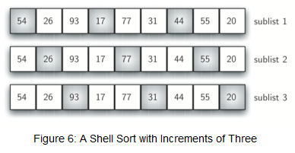
Shell Sort

Slide 34
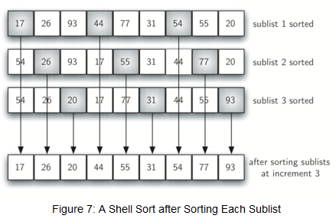
Shell Sort

Slide 35
Shell Sort

Slide 36
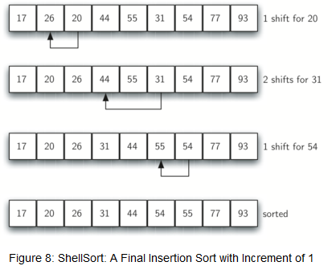
Shell Sort

Slide 37
Counting Sort
Counting sort is a sorting algorithm that sorts the elements of an array by counting the number of occurrences of each unique element in the array.

Slide 38
Counting Sort
Database needed-
Original Array/Input Array
Count Array/Auxillary Array
Take a count array to store the count of each unique object.
Store the count of each element at their respective index in count array
For example: if the count of element 3 is 2 then, 2 is stored in the 3rd position of count array.
If element "5" is not present in the array, then 0 is stored in 5th position.

Slide 39
Counting Sort
Store cumulative sum of the elements of the count array. It helps in placing the elements into the correct index of the sorted array.
The modified count array indicates the position of each object in the output sequence.
After placing each element at its correct position, decrease its count by one.

Slide 40
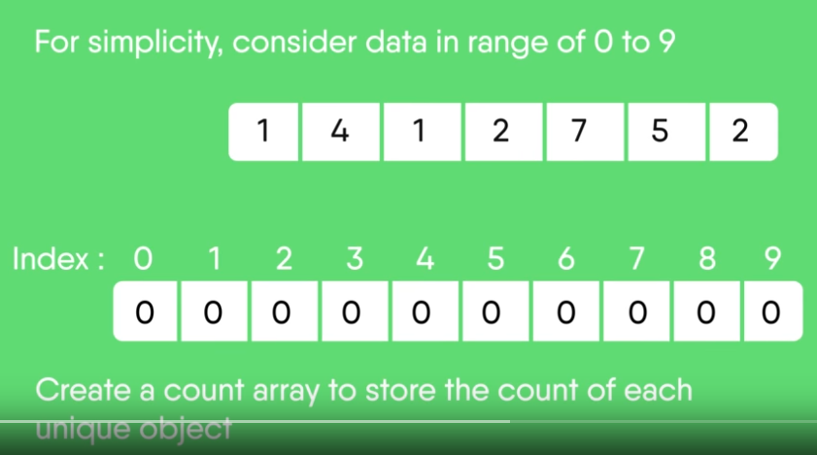
Counting Sort
Let us take an auxiliary array/count array from 0 to 9 for simplicity

Slide 41
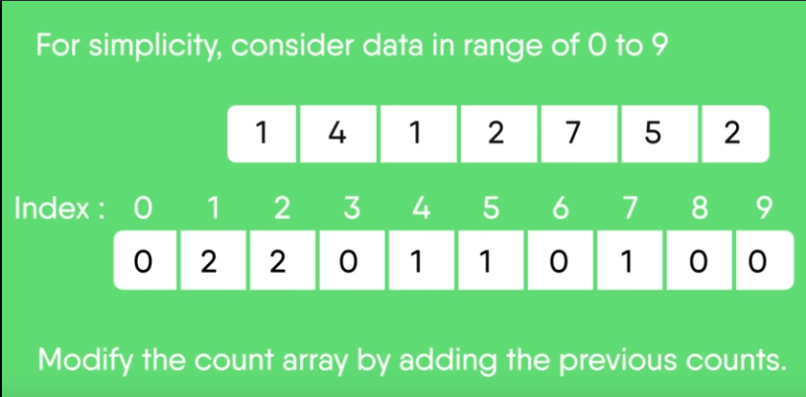
Counting Sort

Slide 42
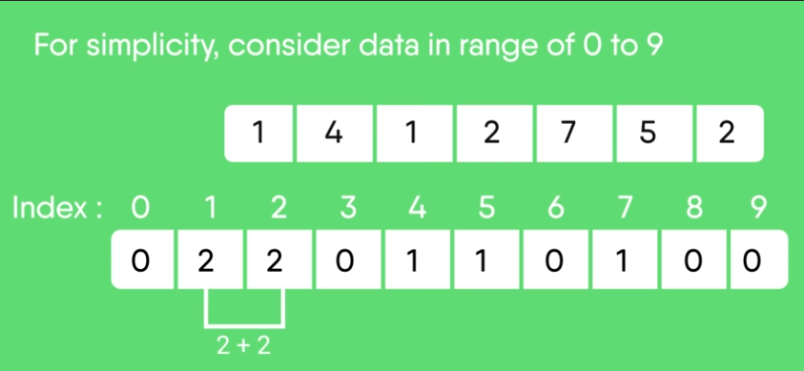
Counting Sort

Slide 43
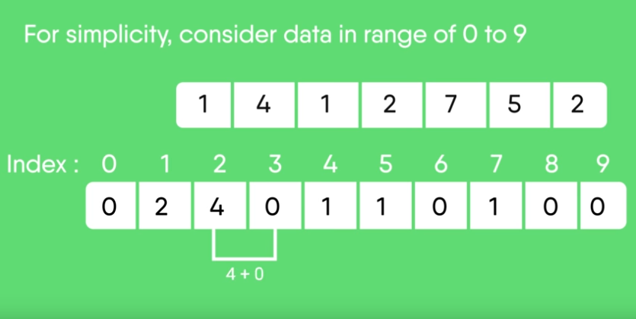
Counting Sort

Slide 44
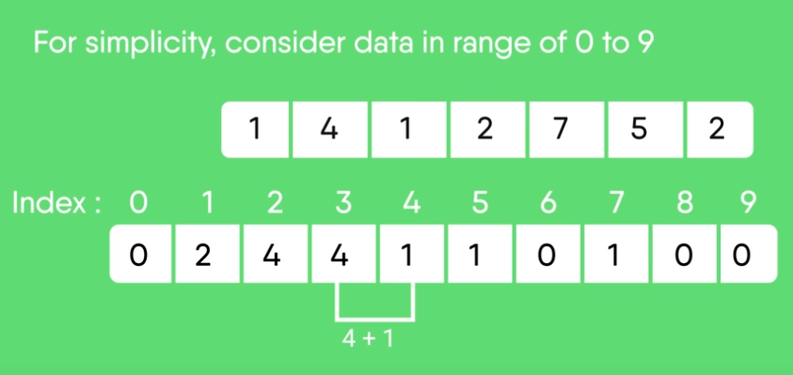
Counting Sort

Slide 45
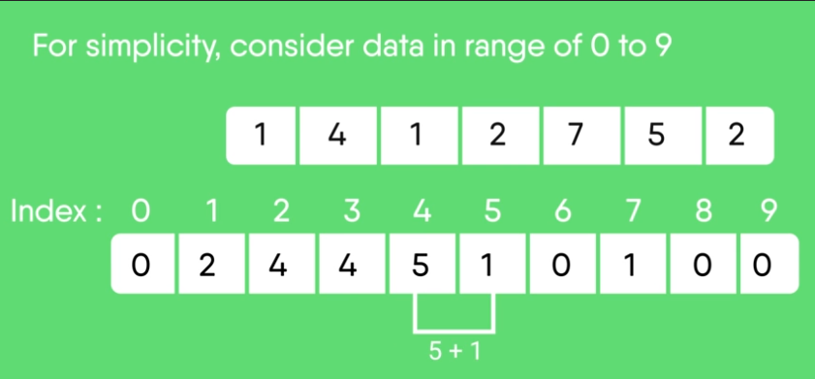
Counting Sort

Slide 46
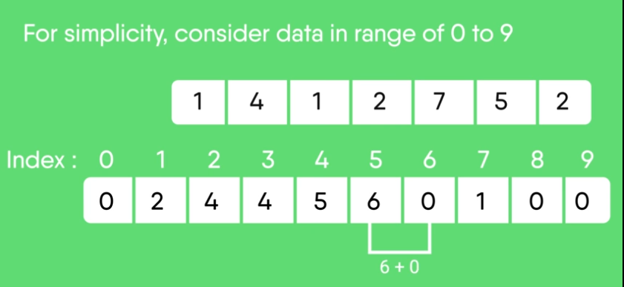
Counting Sort

Slide 47
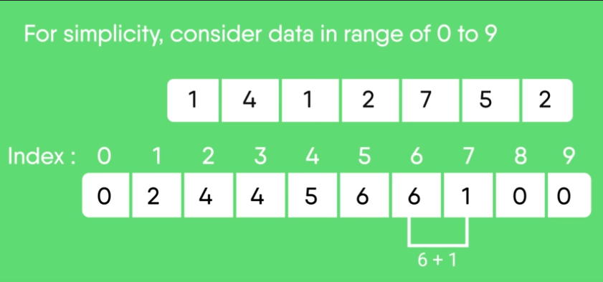
Counting Sort

Slide 48
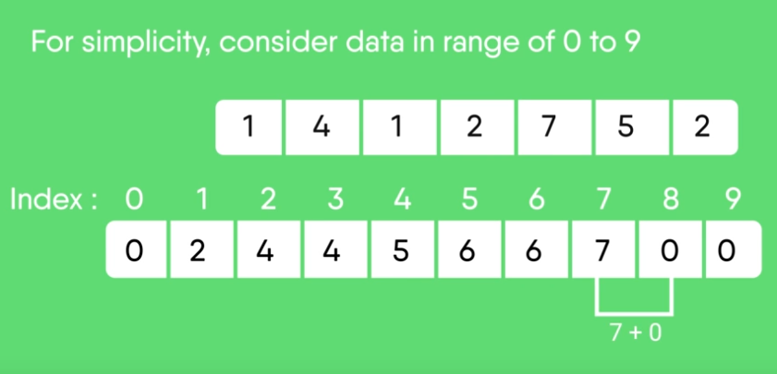
Counting Sort

Slide 49

Counting Sort

Slide 50

Counting Sort

Slide 51
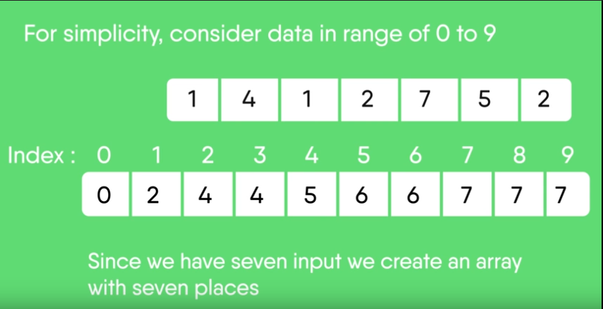
Counting Sort

Slide 52
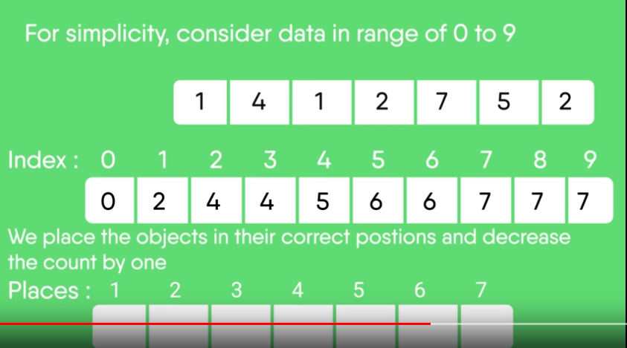
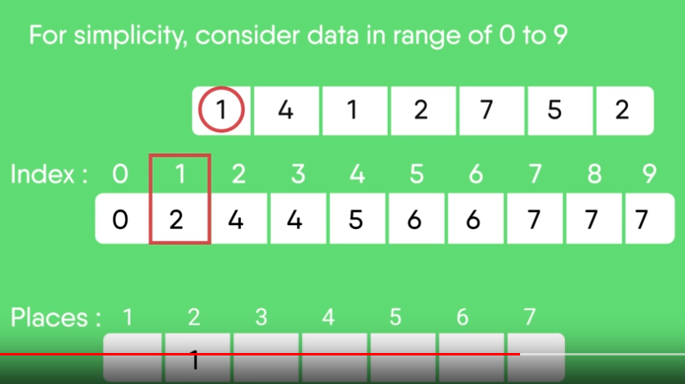
Counting Sort

Slide 53
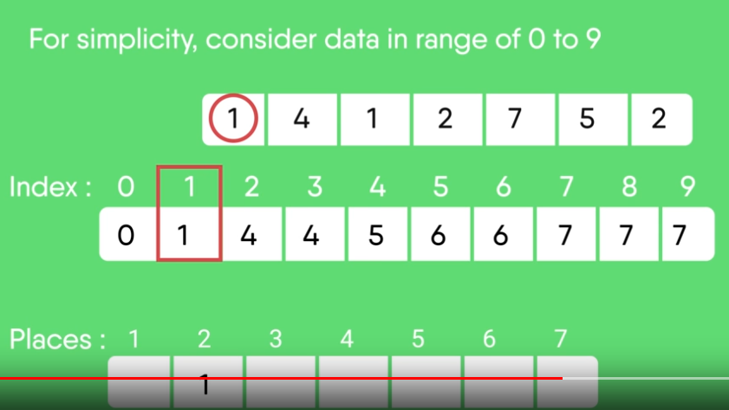
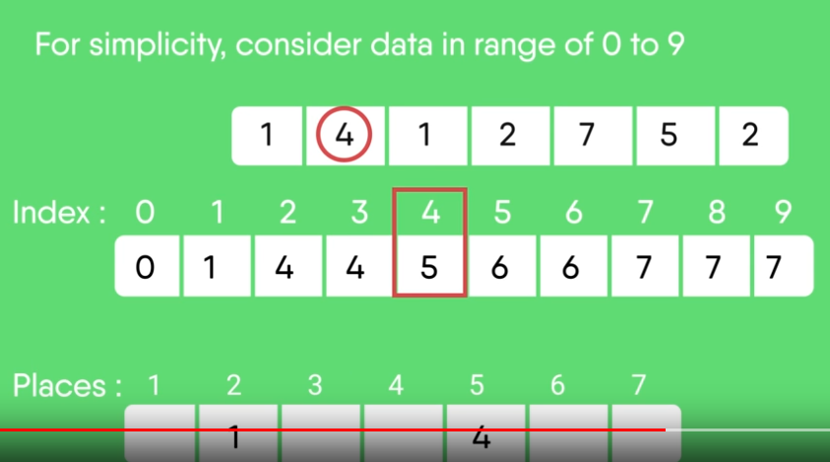
Counting Sort

Slide 54

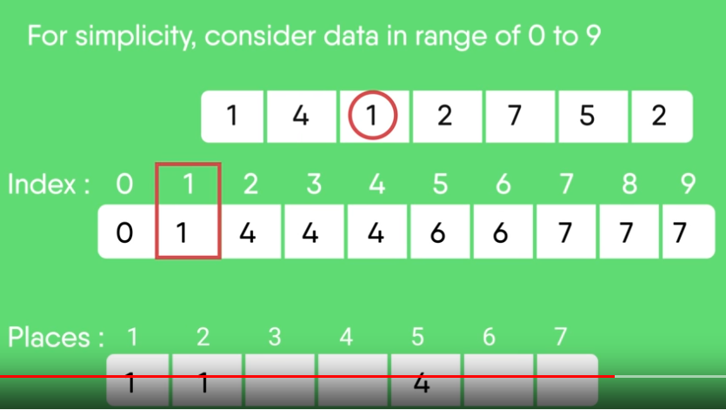
Counting Sort

Slide 55
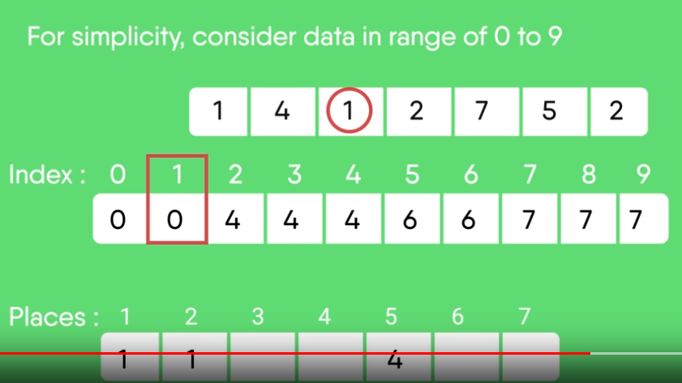
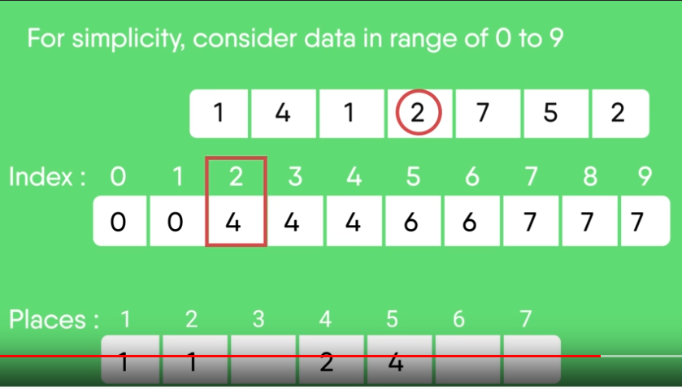
Counting Sort

Slide 56
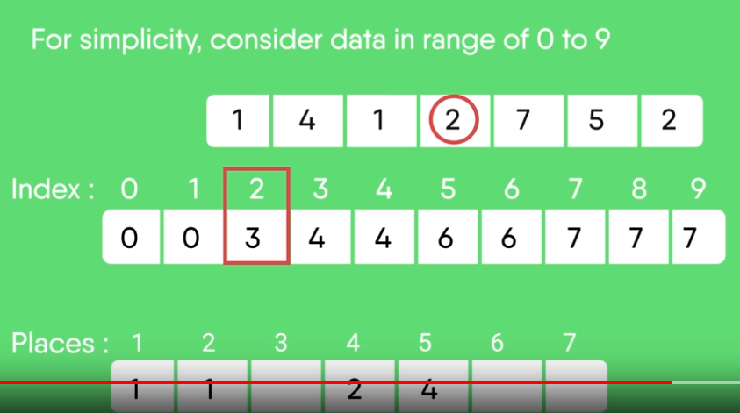
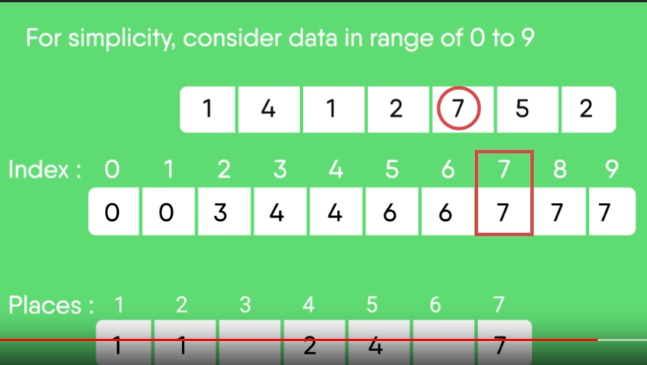
Counting Sort

Slide 57

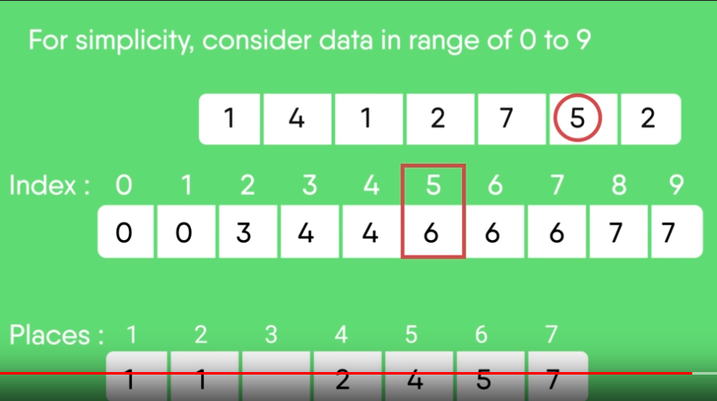
Counting Sort

Slide 58
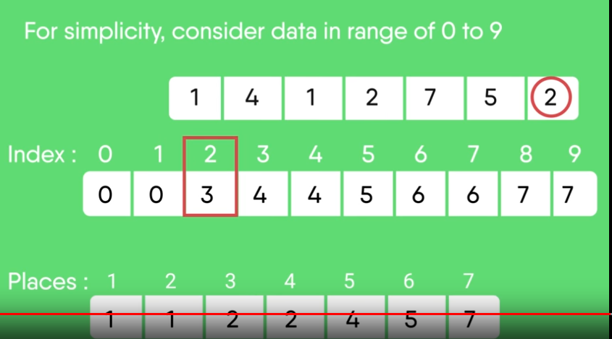
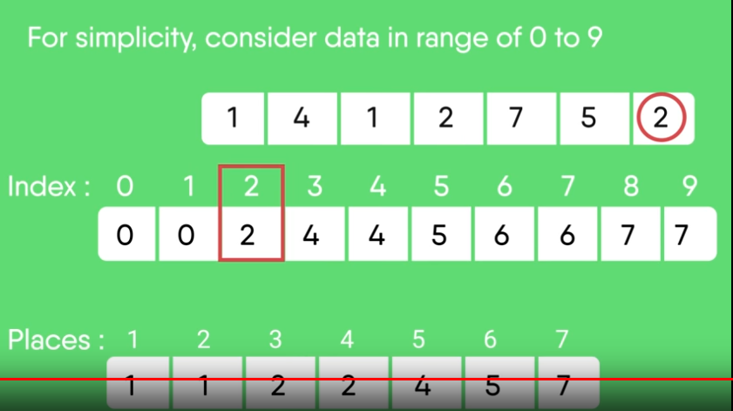
Counting Sort

Slide 59
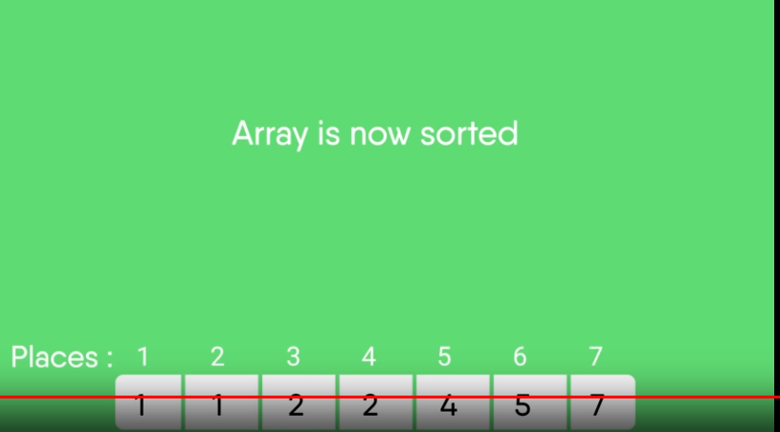
Counting Sort

Slide 60
Example
8 | 4 | 2 | 2 | 8 | 3 | 3 | 1
Sort the array of 8 elements using Counting Sort

Slide 61
Example 2
8 | 4 | 2 | 2 | 8 | 3 | 3 | 1
Let us take an auxiliary array/count array from 0 to 9 for simplicity

Slide 62
Example 2
8 | 4 | 2 | 2 | 8 | 3 | 3 | 1
Sort the array of 8 elements using Counting Sort
0 | 1 | 2 | 3 | 4 | 5 | 6 | 7 | 8
0 | 1 | 2 | 2 | 1 | 0 | 0 | 0 | 2

Slide 63
Example 2
8 | 4 | 2 | 2 | 8 | 3 | 3 | 1
Sort the array of 8 elements using Counting Sort
Cumulative Count array –
0 | 1 | 2 | 3 | 4 | 5 | 6 | 7 | 8
0 | 1 | 2 | 2 | 1 | 0 | 0 | 0 | 2
0 | 1 | 2 | 3 | 4 | 5 | 6 | 7 | 8
0 | 1 | 3 | 5 | 6 | 6 | 6 | 6 | 8

Slide 64
Example 2
8 | 4 | 2 | 2 | 8 | 3 | 3 | 1
Cumulative Count array –
Place the objects in the correct place and decrease the count by 1
Check for Object 8, Count=8,
Place at 8th Position and decrement count by 1
Cumulative Count Array-
0 | 1 | 2 | 3 | 4 | 5 | 6 | 7 | 8
0 | 1 | 3 | 5 | 6 | 6 | 6 | 6 | 8
1 | 2 | 3 | 4 | 5 | 6 | 7 | 8
 |  |  |  |  |  |  | 8
0 | 1 | 2 | 3 | 4 | 5 | 6 | 7 | 8
0 | 1 | 3 | 5 | 6 | 6 | 6 | 6 | 7

Slide 65
Example 2
8 | 4 | 2 | 2 | 8 | 3 | 3 | 1
Cumulative Count array –
Place the objects in the correct place and decrease the count by 1
Check for Object 4, Count=6,
Place at 6th Position and decrement count by 1
Cumulative Count Array-
0 | 1 | 2 | 3 | 4 | 5 | 6 | 7 | 8
0 | 1 | 3 | 5 | 6 | 6 | 6 | 6 | 7
1 | 2 | 3 | 4 | 5 | 6 | 7 | 8
 |  |  |  |  | 4 |  | 8
0 | 1 | 2 | 3 | 4 | 5 | 6 | 7 | 8
0 | 1 | 3 | 5 | 5 | 6 | 6 | 6 | 7

Slide 66
Example 2
8 | 4 | 2 | 2 | 8 | 3 | 3 | 1
Cumulative Count array –
Place the objects in the correct place and decrease the count by 1
Check for Object 2, Count=3,
Place object at 3th Position and decrement count by 1
Cumulative Count Array-
0 | 1 | 2 | 3 | 4 | 5 | 6 | 7 | 8
0 | 1 | 3 | 5 | 5 | 6 | 6 | 6 | 7
1 | 2 | 3 | 4 | 5 | 6 | 7 | 8
 |  | 2 |  |  | 4 |  | 8
0 | 1 | 2 | 3 | 4 | 5 | 6 | 7 | 8
0 | 1 | 2 | 5 | 5 | 6 | 6 | 6 | 7

Slide 67
Example 2
8 | 4 | 2 | 2 | 8 | 3 | 3 | 1
Cumulative Count array –
Place the objects in the correct place and decrease the count by 1
Check for Object 2, Count=2,
Place object at 2nd Position and decrement count by 1
Cumulative Count Array-
0 | 1 | 2 | 3 | 4 | 5 | 6 | 7 | 8
0 | 1 | 2 | 5 | 5 | 6 | 6 | 6 | 7
1 | 2 | 3 | 4 | 5 | 6 | 7 | 8
 | 2 | 2 |  |  | 4 |  | 8
0 | 1 | 2 | 3 | 4 | 5 | 6 | 7 | 8
0 | 1 | 1 | 5 | 5 | 6 | 6 | 6 | 7

Slide 68
Example 2
8 | 4 | 2 | 2 | 8 | 3 | 3 | 1
Cumulative Count array –
Place the objects in the correct place and decrease the count by 1
Check for Object 8, Count=7,
Place object at 7th Position and decrement count by 1
Cumulative Count Array-
0 | 1 | 2 | 3 | 4 | 5 | 6 | 7 | 8
0 | 1 | 1 | 5 | 5 | 6 | 6 | 6 | 7
1 | 2 | 3 | 4 | 5 | 6 | 7 | 8
 | 2 | 2 |  |  | 4 | 8 | 8
0 | 1 | 2 | 3 | 4 | 5 | 6 | 7 | 8
0 | 1 | 1 | 5 | 5 | 6 | 6 | 6 | 6

Slide 69
Example 2
8 | 4 | 2 | 2 | 8 | 3 | 3 | 1
Cumulative Count array –
Place the objects in the correct place and decrease the count by 1
Check for Object 3, Count=5,
Place object at 5th Position and decrement count by 1
Cumulative Count Array-
0 | 1 | 2 | 3 | 4 | 5 | 6 | 7 | 8
0 | 1 | 1 | 5 | 5 | 6 | 6 | 6 | 7
1 | 2 | 3 | 4 | 5 | 6 | 7 | 8
 | 2 | 2 |  | 3 | 4 | 8 | 8
0 | 1 | 2 | 3 | 4 | 5 | 6 | 7 | 8
0 | 1 | 1 | 4 | 5 | 6 | 6 | 6 | 6

Slide 70
Example 2
8 | 4 | 2 | 2 | 8 | 3 | 3 | 1
Cumulative Count array –
Place the objects in the correct place and decrease the count by 1
Check for Object 3, Count=4,
Place object at 5th Position and decrement count by 1
Cumulative Count Array-
0 | 1 | 2 | 3 | 4 | 5 | 6 | 7 | 8
0 | 1 | 1 | 4 | 5 | 6 | 6 | 6 | 7
1 | 2 | 3 | 4 | 5 | 6 | 7 | 8
 | 2 | 2 | 3 | 3 | 4 | 8 | 8
0 | 1 | 2 | 3 | 4 | 5 | 6 | 7 | 8
0 | 1 | 1 | 3 | 5 | 6 | 6 | 6 | 6

Slide 71
Example 2
8 | 4 | 2 | 2 | 8 | 3 | 3 | 1
Cumulative Count array –
Place the objects in the correct place and decrease the count by 1
Check for Object 1, Count=1,
Place object at 1st Position and decrement count by 1
Cumulative Count Array-
0 | 1 | 2 | 3 | 4 | 5 | 6 | 7 | 8
0 | 1 | 1 | 4 | 5 | 6 | 6 | 6 | 7
1 | 2 | 3 | 4 | 5 | 6 | 7 | 8
1 | 2 | 2 | 3 | 3 | 4 | 8 | 8
0 | 1 | 2 | 3 | 4 | 5 | 6 | 7 | 8
0 | 0 | 1 | 3 | 5 | 6 | 6 | 6 | 6

Slide 72
Example 2
Input Array-
Sorted array-
8 | 4 | 2 | 2 | 8 | 3 | 3 | 1
Position | 1 | 2 | 3 | 4 | 5 | 6 | 7 | 8
Value | 1 | 2 | 2 | 3 | 3 | 4 | 8 | 8

